Slide 1

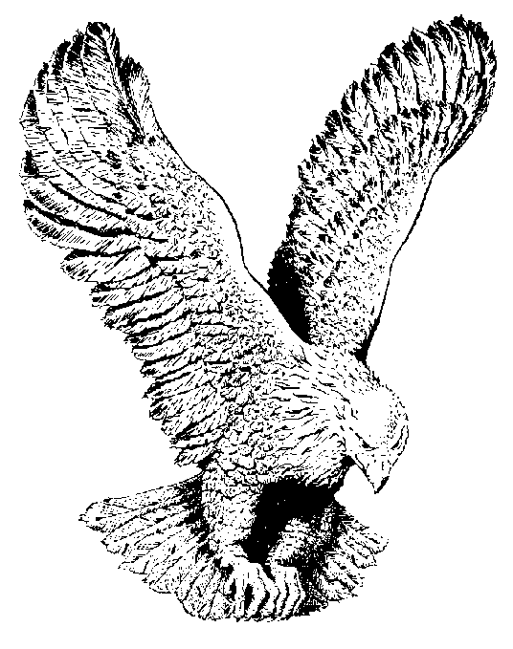
651 THE BLOOD PREVAILS
The blood prevails, the blood of the bleeding lamb
Power to save, just like in olden days
The blood prevails, no matter what the people say
Thank God the blood prevails.

Slide 2
Thank God for the cleansing blood
Thank God for the cleansing blood
Thank God for the cleansing blood
That washes white as snow.

